Slide 1

EPCO Engineering Procurement & Contracts Private Limited
I Architectural & Engineering Design Consultancy I PMC I Construction I Real Estate I Interior Design & Fit Outs I Building Maintenance I
Our Mission
EPCO, A System Driven Organization Is Committed To Meet The Customer’s Expectation Every Time On Top Priority
To Provide End To End Solution To All Our Customers
To Act As A Single Point Contact With Accountability To The Customers
To Become A Customer Centric Brand Through Outstanding Performance
Our Vision
Continuously Upgrading Ourselves By Updating Our Knowledge & Systems Every Day Through Improvising New Ideas With New Age Technologies To Sustain For A Longer Journey
To Ensure All Customers Are Satisfied With Our High Quality Services At All Times
Our Commitment
We Deliver What We Promise
A EPCO Group Company
I EPC Construction I Health Care Services I

Slide 2
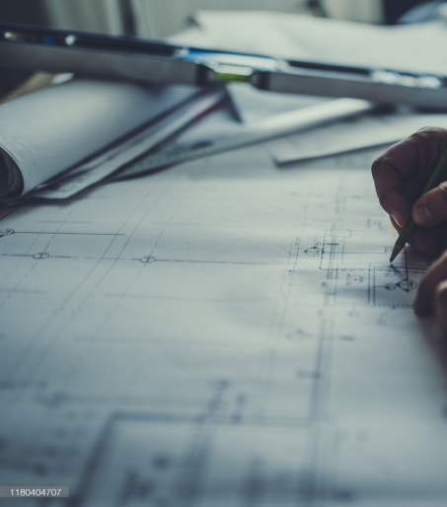



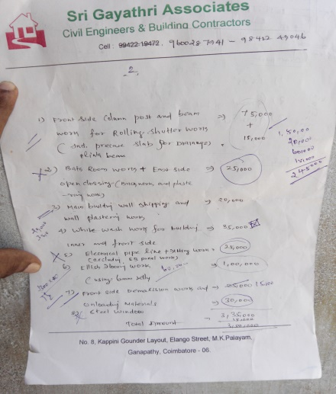
EPCO Engineering Procurement & Contracts Private Limited
I Architectural & Engineering Design Consultancy I PMC I Construction I Real Estate I Interior Design & Fit Outs I Building Maintenance I
BUSINESS VERTICAL DIVISIONS
Architectural & Engineering Design Consultancy Division
Lay Out & Architectural Plans
Statutory Drawings
Structural Design & Detailed Engineering
Design & Detailing Of MEP Services
Design & Detailing Of Treatment Plants
Design & Detailing Of Horticulture & Landscape
Swimming Pools
Club House & Other Amenities
Project Management Consultancy Division
Steering Team Of The Organization With Empowerment To Complete All Projects On Time
Single Point Of Contact With Accountability To All Customers
Project Planning, Scheduling & Monitoring
Quantity Survey & Billing
Estimation, Budget & Costing
Resource Planning & Allocation
Purchase & Procurement
Handling Of Defects Liability
Project Close Out & Documentation
Ascertaining Customer Satisfaction

Slide 3
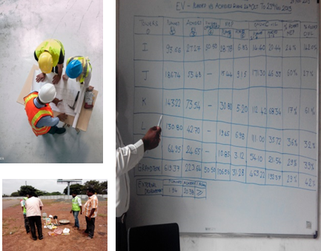
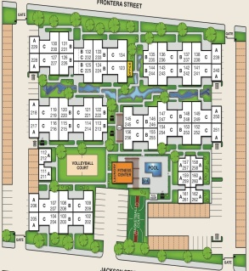
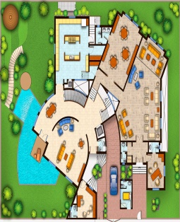

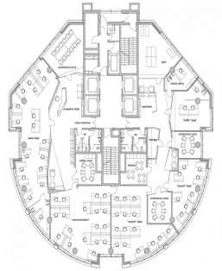
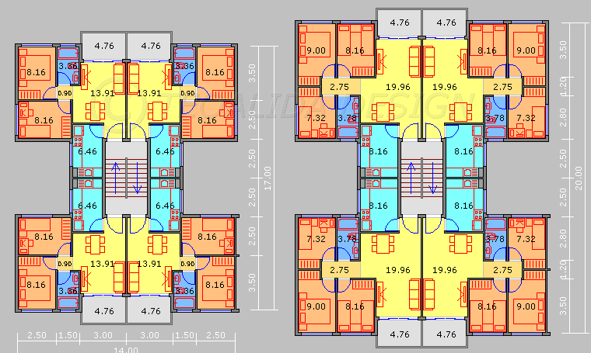
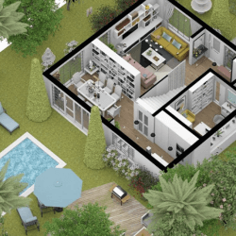
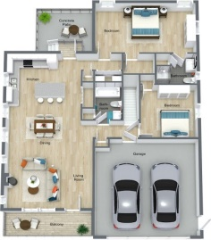

EPCO Engineering Procurement & Contracts Private Limited
I Architectural & Engineering Design Consultancy I PMC I Construction I Real Estate I Interior Design & Fit outs I Building Maintenance I
BUSINESS VERTICAL DIVISIONS
Project Construction Division
Construction Planning & Pre-construction Works
Monitoring Of The Progress In Line With Plan
Deployment & Allocation Of Resources
Qualitative Construction
Timely Completion
Adherence to EHS & Statutory Compliances
Contractual Compliances & Obligations
Periodical Review & Meeting Customer Expectations
Customer Satisfaction
Handing Over & Documentation
Estate Development Division
Consultancy On Appropriate Development Suitable For The Land Parcel Available With The Customer
Joint Ventures & Joint Developments
Viability & Feasibility Reports
Liaison & Statutory Approvals
Appointment Of Architects & Consultants
Sales & Marketing Support
Customer Relation Management Activities
Customer Accounts & Data Base Maintenance
Handing Over To End Customers Including Defects Liability

Slide 4




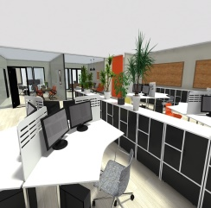
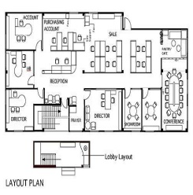






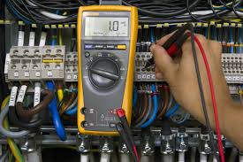

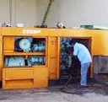
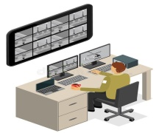

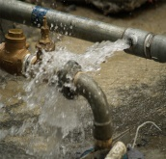
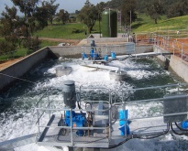
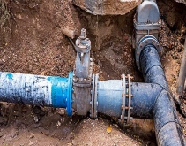

EPCO Engineering Procurement & Contracts Private Limited
I Architectural & Engineering Design Consultancy I PMC I Construction I Real Estate I Interior Design & Fit outs I Building Maintenance I
BUSINESS VERTICAL DIVISIONS
Interior Design & Fit Outs Division
Understanding The Needs Of The Customer
Design & Customer Approval
Coordination With Various Services Team Members
Execution Of Interior Fit Outs With Qualitative Outputs
Vendor Management For Successful Accomplishment On Time
Residential, Commercial, IT Parks And Office Complex Projects
Building Maintenance Services Division
Part – A: Customer Account Maintenance
Maintenance Of Customer Database
Automated Invoice / Maintenance Billing System Through ERP (OR) Equivalent Software
Payment Collection Service (On Behalf Of Our Customer Association)
Bank Reconciliation Statements
Auditing Of Association Accounts
Part – B: Manpower Supply
Housekeeping
Gardening & Landscape
Electrical, Plumbing, DG Sets, Etc.
Security & Surveillance
Pest Control
Water Bodies And Swimming Pools
Treatment Plants

Slide 5



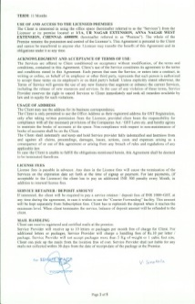


EPCO Engineering Procurement & Contracts Private Limited
I Architectural & Engineering Design Consultancy I PMC I Construction I Real Estate I Interior Design & Fit outs I Building Maintenance I
SUPPORTING SERVICES & DEPARTMENTS
Business Development & Marketing Department
Marketing, Research & Development
Branding
Lead Generation & Conversion
Joint Ventures & Developments
Continuous Research & Development for improvement
Empowered Team for Customer Satisfaction & Compliances
Continuous Inputs For Product & Service Improvement
Tendering & Contracts Department
Handling of Tenders
Submission of Bids
Market Study & Analysis for Price Competition
Negotiation & Finalization
Signing of Contracts
Accomplishment of Contractual Obligations

Slide 6
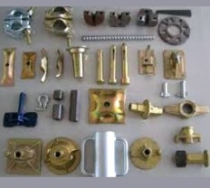
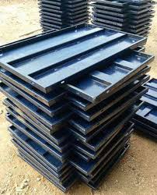
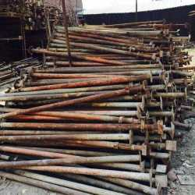
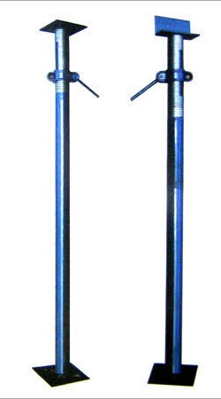

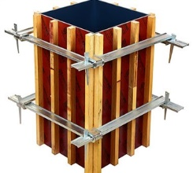
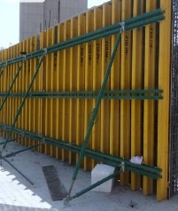

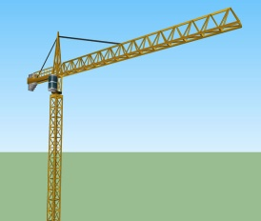


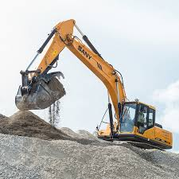
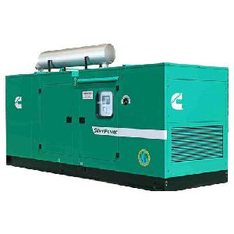
EPCO Engineering Procurement & Contracts Private Limited
I Architectural & Engineering Design Consultancy I PMC I Construction I Real Estate I Interior Design & Fit Outs I Building Maintenance I
SUPPORTING SERVICES & DEPARTMENTS
Form Work Department
Design Of Efficient Form Work System
Form Work Material Planning
Optimum Utilization Of Plywood, Timber & Other Materials
Maintenance Of Form Work Materials
Training & Development Of Skill Set
Adherence To Quality & Safety Standards
Monitoring Of Productivity
Maintenance Of Stock Of Form Work Materials
Plant & Machinery Department
Identification Of Ideal Plant & Machinery Requirement
Periodical Maintenance
Asset Management
Safety Compliance
Monitoring Of Productivity

Slide 7



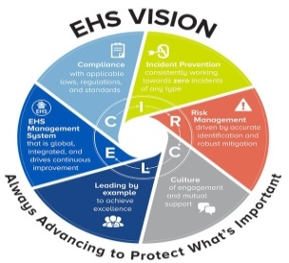
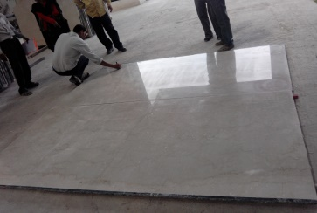
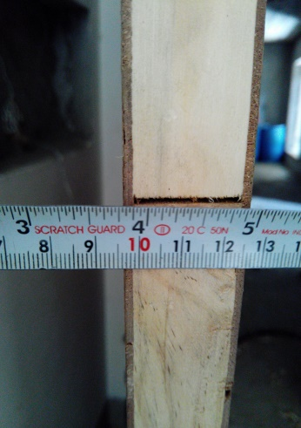
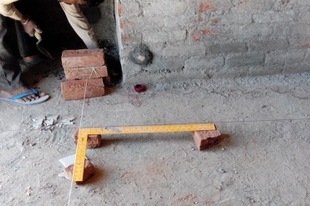
EPCO Engineering Procurement & Contracts Private Limited
I Architectural & Engineering Design Consultancy I PMC I Construction I Real Estate I Interior Design & Fit Outs I Building Maintenance I
SUPPORTING SERVICES & DEPARTMENTS
Environment Health & Safety Department
Project EHS Plan For All The Projects
Standard Operating Procedures For EHS
Establishment Of First Aid Centres At All Projects
Ensuring Safety Compliances And Implementation
Ensuring Statutory Compliances For The Projects
Pep Talks, Tool Box Meetings & Training Of Resources
Imparting Knowledge On The Importance Of Safety
Mock Drills & Safe Evacuation
Periodical Health Screening
Safety Committee Formation & Continuous Review
Quality Management System Department
Project Quality Plan For All The Projects
Standard Operating Procedures For Standardization
Quality Control Laboratory
Ensuring Quality Control On The Products
Ensuring Process Checks At Various Stages Of Works
Ascertaining Quality Assurance To The Customers
Continual Improvement Of Performance
Continuous Training & Development Of Resources
Imparting Knowledge On The Need Of Product Quality
Product Quality Rating System For Product Quality Enhancement
Front Line Responsive Team For The Customer Satisfaction

Slide 8
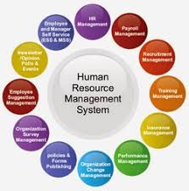

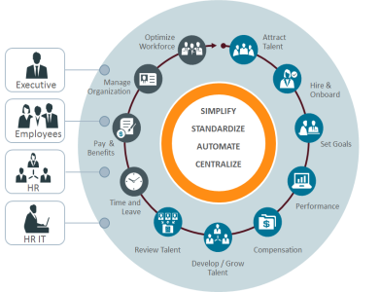
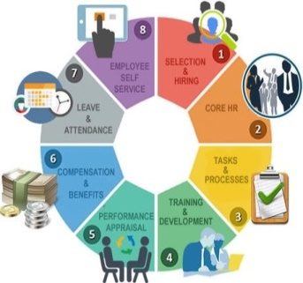



EPCO Engineering Procurement & Contracts Private Limited
I Architectural & Engineering Design Consultancy I PMC I Construction I Real Estate I Interior Design & Fit Outs I Building Maintenance I
SUPPORTING SERVICES & DEPARTMENTS
Personal & Administration Department
Recruitment, Induction & Training Of Manpower As Per Policy
Employee Welfare & Benefits
Tracking Of Performance Evaluation & Appraisal
Statutory License & Approvals
Sticking On To All Statutory Compliances
Labour Welfare & Camp Maintenance
Time Office & Up Keeping Of All Records
Handling All Liasioning Affairs
To Ensure Trouble Free Operations Of The Customer from Administration Perspective
Finance & Accounts Department
Project Funding & Financing
Banking & Financial Activities
Collection Of Payments
Accounting, Pay Outs & Payment Follow Up
Statutory Payments On Time
Supporting Of Project Sites
Cash Flows – Inflow & Outflows
Maintaining Ledgers
Tracking Budget & Cost

Slide 9








EPCO Engineering Procurement & Contracts Private Limited
I Architectural & Engineering Design Consultancy I PMC I Construction I Real Estate I Interior Design & Fit Outs I Building Maintenance I
SUPPORTING SERVICES & DEPARTMENTS
Information Technology Department
Setting Up Of IT Infrastructure For The Projects
Providing Communication Channels
Establishment Of Connectivity For Seamless Flow Of Activities
Validation Of Software For The Organization And Sites
Asset Management Of IT Infrastructure Assets
Tracking & Monitoring The Usage Of Network System
Acting As A Data Centre For The Organization
Audit Department
Identification Of Key Area Of Audit
Periodical Internal Audits To Find The Gaps
Statutory Audits
System & Quality Audit
Safety Audits
Technical Audit
External Audit – Coordination & Closure
Ascertaining Closure Of Audit Reports
Feedback To Management For Effectiveness & Improvements In The System

Slide 10
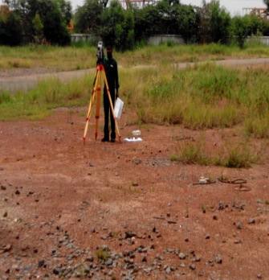
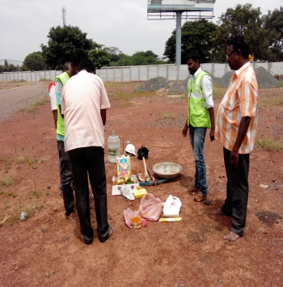
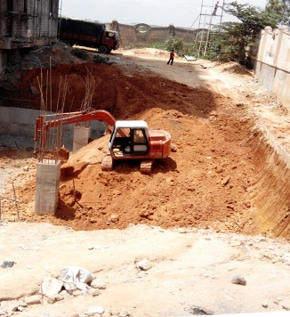
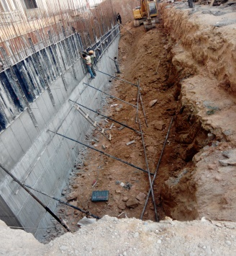
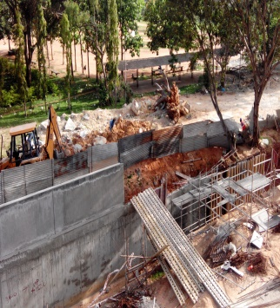
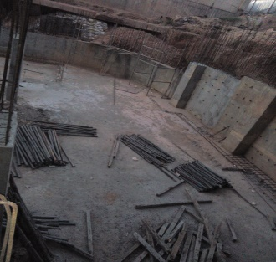
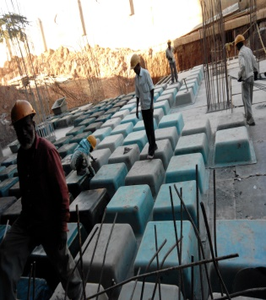
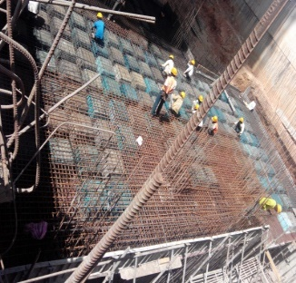
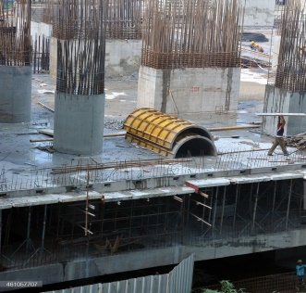
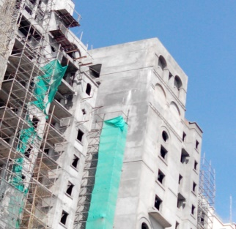
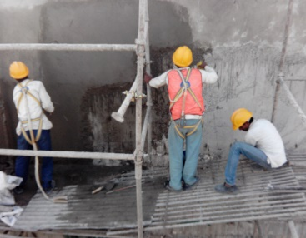
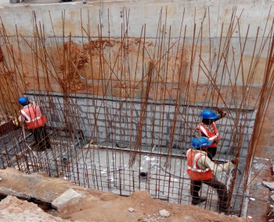
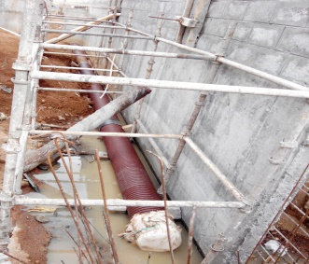
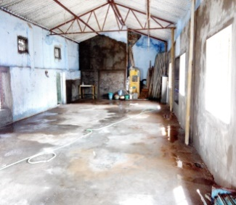
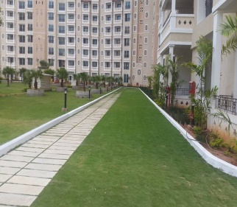
EPCO Engineering Procurement & Contracts Private Limited
I Architectural & Engineering Design Consultancy I PMC I Construction I Real Estate I Interior Design & Fit Outs I Building Maintenance I
PROJECTS HANDLED BY THE TEAM

Slide 11
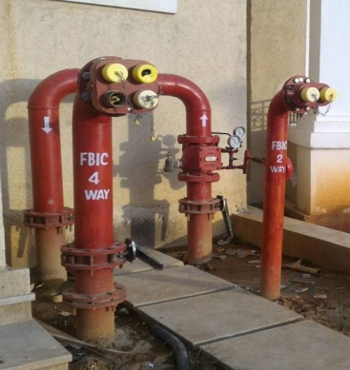











EPCO Engineering Procurement & Contracts Private Limited
I Architectural & Engineering Design Consultancy I PMC I Construction I Real Estate I Interior Design & Fit Outs I Building Maintenance I
PROJECTS HANDLED BY THE TEAM

Slide 12







EPCO Engineering Procurement & Contracts Private Limited
I Architectural & Engineering Design Consultancy I PMC I Construction I Real Estate I Interior Design & Fit Outs I Building Maintenance I
PROJECTS HANDLED BY THE TEAM

Slide 13
EPCO Engineering Procurement & Contracts Private Limited
I Architectural & Engineering Design Consultancy I PMC I Construction I Real Estate I Interior Design & Fit outs I Building Maintenance I
SERVICES PROVIDED BY THE ORGANIZATION
Field of Services
Architectural & Engineering Design Consultancy
Project Management Consultancy
Project Construction Contracts
Estate Development
Interior Design & Fit Outs
Building Maintenance Service
We have our Foot Prints into
Residential Projects (Villas, High Rise Apartments, Gated Communities, Etc.)
Industrial Projects (Green Field & Brown Field Including Renovation Works)
Hospital & Hospitality Projects
Turn Key Projects (Design & Build Projects Within Budget Figures)
Interior Design & Fit Outs
Treatment Plants
Show Rooms
Building Maintenance Services
Contact us
EPCO Engineering Procurement & Contracts Private Limited,
Senate Space,
1/1A, Ground Floor, UR Nagar Extension, Anna Nagar West Extension,
Chennai, Tamil Nadu
PIN: 600 050
I +91-44-79694593 I +91-9345915002 I +91-9962003062 I
I epcogroupcompanies@gmail.com I
I CIN: U45309TN2020PTC137334 I MSME: UDYAM-TN-02-0014593 I
I GSTIN: 33AAGCE0391M1ZK I PAN: AAGCE0391M I

